Slide 1
CCTV Bird detection and identification.
By Aidan Moore

Slide 2
Climate Change and bird populations
Climate impact on birds:
Population growth and reproduction
Migration
Extinction
Seasonal migrating bird face the most challenge
Gregory RD, Willis SG, Jiguet F, Voříšek P, Klvaňová A, van Strien A, Huntley B, Collingham YC, Couvet D, Green RE. An indicator of the impact of climatic change on European bird populations. PloS one. 2009 Mar 4;4(3):e4678.

Slide 3
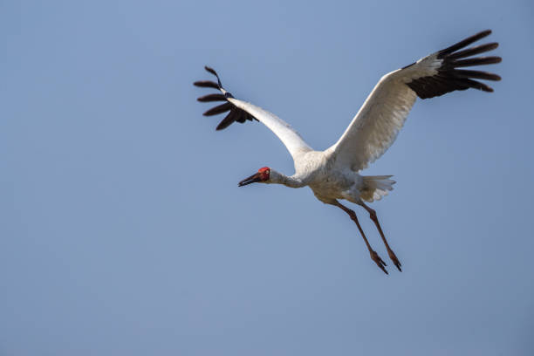
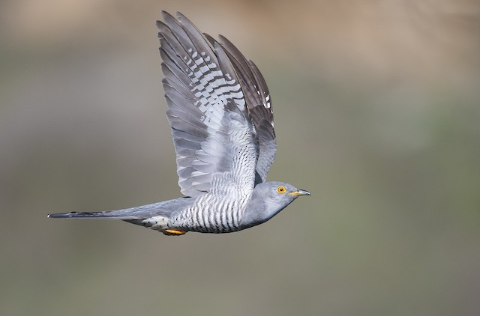
Siberian Crane
Common Cuckoo
Siberian Crane
Yi K, Zhang J, Batbayar N, Higuchi H, Natsagdorj T, Bysykatova IP. Using Tracking Data to Identify Gaps in Knowledge and Conservation of the Critically Endangered Siberian Crane (Leucogeranus leucogeranus). Remote Sensing. 2022 Oct 12;14(20):5101.
Hewson CM, Thorup K, Pearce-Higgins JW, Atkinson PW. Population decline is linked to migration route in the Common Cuckoo. Nature Communications. 2016 Jul 19;7(1):12296.
Notes:
Siberian crane estimate 3000-4000, population decreasing for decade climate change causing habitat degradation. Common cuckoo seen a decrease

Slide 4
How can image analysis help?
Detection of objects within is an easy task for humans, but hard for computer.
CNN – Have become the best network for image classification. CNN Architectures include – VGG-19, ResNet, GhostNet
Real time identification so need to fast and efficient

Slide 5
https://arxiv.org/abs/1409.1556
https://arxiv.org/abs/1512.03385
https://arxiv.org/abs/1911.11907

Slide 6
Aims
https://www.kaggle.com/datasets/gpiosenka/100-bird-species
Dataset provide 80,085 images for training and 2500 for test.
Use the 3 architectures mentioned, use evaluation metrics like accuracy, precision, recall, F1-Score.
Take the best one and tune hyperparameters such as kernel size, stride and learning rate.

Slide 7
Alternate test images
Images in the test set are very clear clean
Can test on images provided from home CCTV camera
Notes:
Get image from cctv

Slide 8
USE CHARTS TO EXPLAIN YOUR IDEAS
White
Gray
Black

Slide 9
Roadmap
Blue is the colour of the clear sky and the deep sea
Red is the colour of danger and courage
Black is the color of ebony and of outer space
1
3
5
2
4
6
Yellow is the color of gold, butter and ripe lemons
White is the color of milk and fresh snow
Blue is the colour of the clear sky and the deep sea

